Slide 1

1. TiGL Workshop - How to contribute + Hands On
Jan Kleinert, Martin Siggel
September 11./12. 2018, Cologne

Slide 2







TiGL is Open-Source
TiGL is mainly developed at Airbus D&S, RISC and DLR
But as TiGL is an Open-Source project, anyone can contribute!
Three Ways to contribute:
Send feedback or tell us about your work in the TiGL ecosystem: martin.siggel@dlr.de, jan.kleinert@dlr.de
Report issues on https://github.com/DLR-SC/tigl/issues
Develop a feature and post a pull-request
Apache 2.0 License
Content of this session

Slide 3
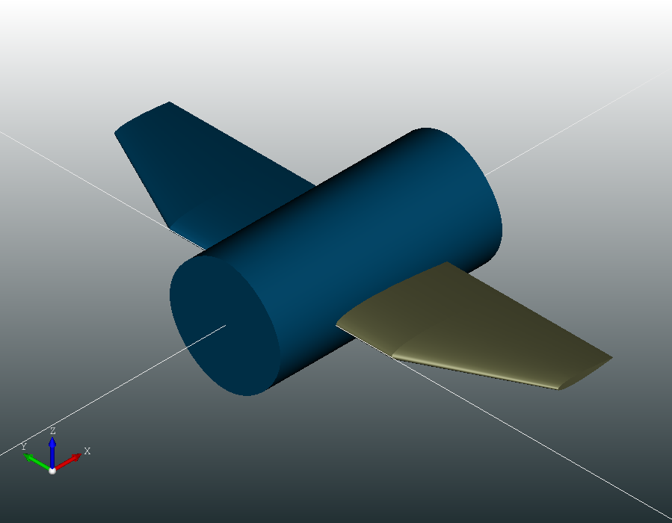
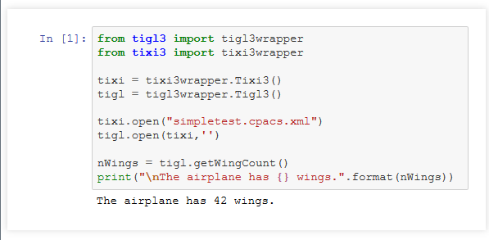

Consider TiGL’s “Hello World Script”
We have found a bug!!

Slide 4
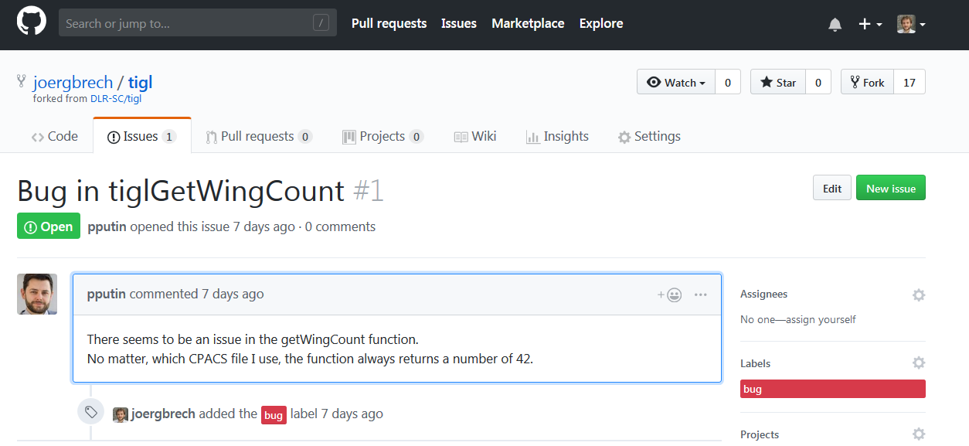

It’s time to take matters into our own hands!
Luckily, the bug is not in the original TiGL repository, but only in my personal fork https://github.com/joergbrech/tigl
Paul already spotted it and reported the bug a while ago using the issue tracker.
Yet, the TiGL developers seem to be too busy to fix it …

Slide 5
Contents
The TiGL Ecosystem
TiGL architecture in a nut-shell
3rd-Party dependencies and useful tools
Building TiGL from source
Prerequisites
Using Google Test for unit testing
Basic GIT usage (fork, branch, commit, push, pull-request)
Hands-On
Write a Unit Test in our local TiGL build
Fix a bug in your local TiGL build
Create a Fork of the TiGL Github repository
Push your local changes to your personal fork
Share the changes by posting a Pull-Request on Github
Final remarks
Further ways to contribute
Comments and further reading

Slide 6
The TiGL Ecosystem

Slide 7


Architecture
TiXI (https://github.com/dlr-sc/tixi)
Library to parse XML (CPACS) files
OpenCASCADE (https://www.opencascade.com/)
Geometry (NURBS-based)
Topology (Boundary Representation)
CAD Exports, Visualization
Language Bindings
Generated via SWIG (http://www.swig.org/)
Can access all C++ Data structures
TiGL Viewer
3D Visualization
Scripting
Debugging
Matlab
Python
Java
Bindings
TiGL Viewer
TiGL Geometry Library
TiXI XML Interface
OpenCASCADE CAD Kernel

Slide 8
The TiGL SDK
There are a few requirements and useful tools for building TiGL
some precompiled dependencies can be found here: https://sourceforge.net/projects/tigl/files/Thirdparty/
For convenience, we prepared a Windows 32 Bit SDK that includes all these tools
https://sourceforge.net/projects/tigl/files/DevTools/TiGL-SDK-win32.7z/download
Dependencies | Comments
OpenCascade | The CAD kernel behind TiGL
TiXI | Used to parse the CPACS (.xml) files
SDK
6.8.0 (patched)
3.0.2
Required tools
C/C++ compiler
CMake | Used to generate the Make files for compiling and linking
A make program | Used by CMake for compiling and linking
MinGW 5.3.0
3.10
Ninja
Recommended
Qt | Needed to build TiGLViewer
Doxygen | Needed to build the TiGL HTML Documentation
Git | Version control to keep your build syncronized with Github and to help contribute
IDE and debugger | Easier coding (auto-completion, dependencies, debugging …)
5.11
1.8.13
2.15
QtCreator, GDB debugger

Slide 9
Building TiGL from Source
For this Hands-On we assume that
You downloaded the TiGL SDK and followed the instructions in the documentation, i.e.
You cloned the TiGL repository
You built and installed TiGL successfully
You know how to run the the unit-tests and TiGLViewer from your local build
You installed the TiGL Python package from the TiGL SDK MinGW Command Prompt via
If you have set up everything correctly, building TiGL should be as easy as pressing Ctr+B in QtCreator or
$ conda create –n tigl_ws python=3.5 tigl3 jupyter pythreejs numpy –c dlr-sc
$ activate tigl_ws
$ mkdir build
$ cd build
$ cmake ../tigl/
$ ninja install
Assuming CMake finds the dependencies and CMAKE_INSTALL_PREFIX is set to a path with write permission

Slide 10
Prerequisites: Google Test and Git

Slide 11
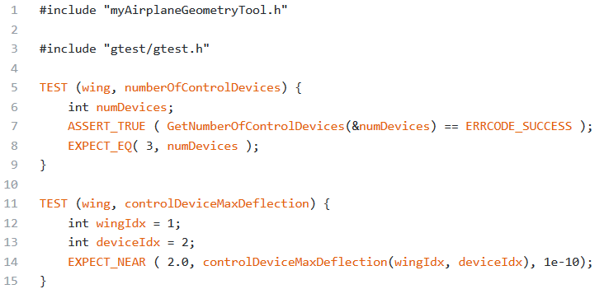
Google Test Framework in a very small nutshell
Basic Idea: Create a separate executable, that tests small portions of your code for correctness.
TiGL uses the GTEST framework from Google for unit testing.
GTEST provides abstract classes and macros for ease of use. Example:

Slide 12
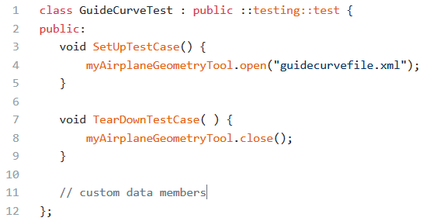
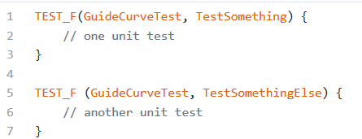
Google Test Framework in a very small nutshell
Test Fixtures are a way to execute custom code before running unit tests, e.g. reading an input file.
A Test Fixture is a class defining the behavior before and after the tests.
Use the TEST_F macro to define a test for a test fixture

Slide 13



Basic Git and Github Usages
Git is a version control system to help you keep track changes to your files
Git assists you in distributed code development
Remote Repository
Remote Repository (forked)
pull request
push
pull upstream
push
pull origin
clone
merge
Local Repository 1
commit
Local Repository 2
branch
fork
push
pull

Slide 14
Hands-On Step 1: Preparation

Slide 15
Preparation: Make sure you use the joergbrech/tigl fork on Github
Remember: The bug we want to fix is only in my fork joergbrech/tigl and not the official TiGLGithub repository
Open the SDK command promt and navigate to your tigl repository
Change the “remote” url so that we synchronize with my buggy fork rather than the offical repository
Verify that everything worked
Synchronize your local repository with the new remote
$ cd tigl
$ git remote set-url origin https://github.com/joergbrech/tigl.git
$ git remote -v
origin https://github.com/joergbrech/tigl.git (fetch)
origin https://github.com/joergbrech/tigl.git (push)
$ git pull

Slide 16
Preparation: Enable the bug in you python package
Open QtCreator, rebuild and install TiGL (Ctrl+B). This will overwrite TIGL_INSTALL_DIRECTORY/bin/libtigl3.dll to include the bug
Replace the TiGL library used by the conda python package with our locally built one.
Navigate to TIGL_SDK_DIRECTORY\tools\python3.6\envs\tigl_ws\Library\bin and make a backup of the file tigl.dll
Now copy the file TIGL_INSTALL_DIRECTORY/bin/libtigl3.dll to TIGL_SDK_DIRECTORY\tools\python3.6\envs\tigl_ws\Library\bin\tigl.dll

Slide 17
Preparation: Verify the bug
Verify the bug in Python
Copy the file TIGL_HOME\tests\unittests\TestData\simpletest.cpacs.xml to a directory of your choice and create a script tigl_bug.py in the same directory with the following contents:
Open the TiGL SDK MinGW Command Prompt, navigate to the directory of your python script and run it
Or download the two files from here:
https://goo.gl/f237cw
$ python tigl_bug.py
The airplane has 42 wings.

Slide 18
Hands-On Step 2: Write a Unit Test

Slide 19
Creating a git branch for the bug fix
We do not want to develop in the main development branch cpacs_3. Therefore, we will create a new branch with a reasonable name (e.g. include your initials, the Github number of Paul‘s issue and a keyword describing the bug).
Navigate to the directory of the tigl source and enter
Make sure you are on the correct branch, by checking the git status
$ git branch jk_1_wingCountBug
$ git checkout jk_1_wingCountBug
$ git status

Slide 20
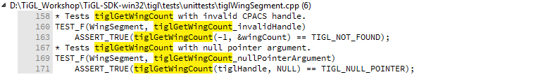
Unit Testing: Write a unit test that checks for the bug
To automatically test for the bug after we fixed it, we will write a unit test. Open QtCreator.
Before we create a new .cpp file in TIGL_HOME\tests, let us first check if there are already unit tests for the function tiglGetWingCount. To do so, press Ctr+Shift+F in QtCreator to open the advanced search. Search for tiglGetWingCount in the entire project
We should keep all unit tests for tiglGetWingCount in the same place, so we will add a unit test to TIGL_HOME\tests\unittests\tiglWingSegment.cpp some where near line 173.

Slide 21
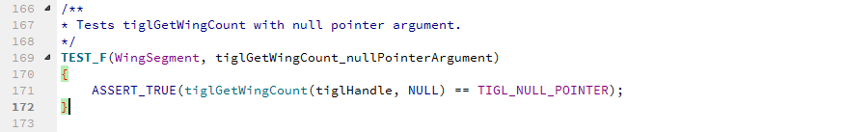
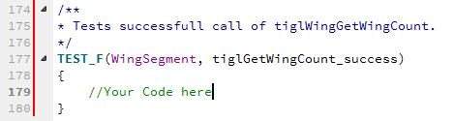
Unit Testing: Write a unit test that checks for the bug
Look at the other unit tests for tiglGetWingCount. They are all based on the class WingSegment:
A look at the class WingSegment in the same file (Ctrl+Click) reveals in the member function SetUpTestCase() that the file "TestData/CPACS_30_D150.xml„ is opened. This is an airplane configuration with three wings (one wing and two tailplanes, the mirrored wings are not counted)
Write a unit test that checks if this wings are counted correctly using ASSERT_EQ and/or ASSERT_TRUE.
If you are unsure how to do this, take a look at a similar unit test for the function tiglWingGetSegmentCount in the same file.

Slide 22
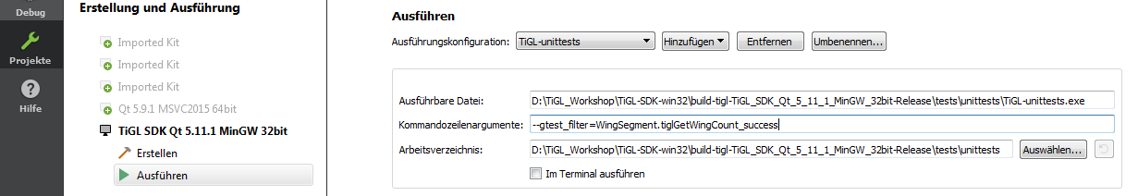
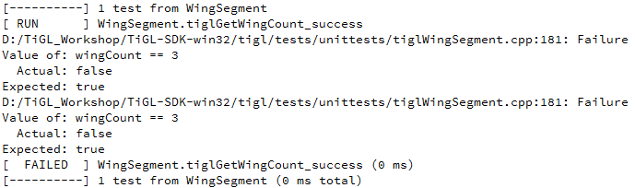
Unit Testing: Write a unit test that checks for the bug
Let‘s see if our unit test fails. First, configure your QtCreator project to only run the newly written test:
Press Ctrl+R to build, install and run the code. We expect it to fail, the bug has not been fixed yet:

Slide 23
Hands-On Step 3: Fix the bug

Slide 24
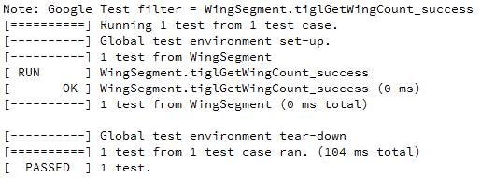
Fix the bug
There is a fairly easy to spot bug in tiglGetWingCount. (For the cheaters: https://goo.gl/tun2pW)
Fix it!
Rerun the unit test (Ctrl+R). This time we expect it to succeed:
To be absolutely sure that everything works now, go ahead and copy the file TIGL_INSTALL_DIRECTORY/bin/libtigl3.dll to TIGL_SDK_DIRECTORY\tools\python3.6\envs\tigl_ws\Library\bin\tigl.dll and rerun your python script:
$ python tigl_bug.py
The airplane has 1 wings.

Slide 25
Commit your changes locally
You want to commit the changes to your newly created branch. Navigate to your tigl directory and enter git status:
Add the files you would like to commit
Commit the changes using a speaking commit message
The hashtag in front of the issue number is interpreted as a reference on Github.
$ git status
On branch jk_1_wingCountBug
Changes not staged for commit:
(use “git add <file>...” to update what will be committed)
(use “git checkout -- <file>...” to discard changes in working directory)
modified: src/api/tigl.cpp
modified: tests/unittests/tiglWingSegment.cpp
$ git add src\api\tigl.cpp
$ git add tests\unittests\tiglWingSegment.cpp
$ git commit –m “fix a bug in tiglGetWingCount, fixes issue #1”

Slide 26
Good job!
We are well on our way! So far you have:
Verified the bug in Python
Created a unit test
Fixed the bug
Verified that the bug is fixed using the unit test and your Python script
Committed the bugfix locally to your version control system (i.e. git).
But so far you are the only one profiting from your bug fix. It’s time to share it with the community.

Slide 27
Hands-On Step 4: Share your changes on Github

Slide 28
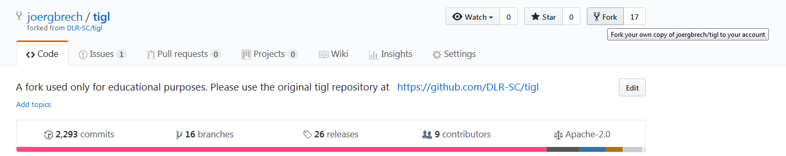
Create a fork of the Github repo to which you want to contribute
You want to push your local commit to the Github repository. You do not have any rights to push to the original repository, so you must first create a personal fork to which you can push your changes.
Log into Github
Navigate to the Github repository https://github.com/joergbrech/tigl and press the „Fork“ button on the top right:

Slide 29
Change the remote of your local repository (again) and push your commit
You want to make sure that you push your local changes to your personal tigl fork. So navigate to your tigl directory and enter
Verify that everything worked:
Your local branch does not exist in your github fork. You can create the remote branch and push your changes to it by entering
Enter your Github credentials.
$ git remote set-url origin https://github.com/YOURUSERNAME/tigl.git
$ git remote -v
origin https://github.com/YOURUSERNAME/tigl.git (fetch)
origin https://github.com/YOURUSERNAME/tigl.git (push)
$ git push --set-upstream origin jk_1_wingCountBug
Replace YOURUSERNAME with your Github user name and jk_1_wingCountBug with the name of your local branch.

Slide 30
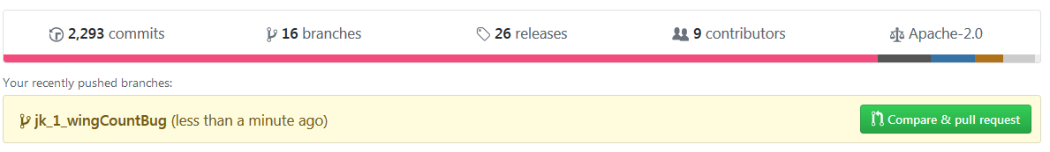

Post a Pull-Request
Take a look at the TiGL fork in your Github account. You will see that you committed a new branch and can now post a pull-request
Press the button “Compare & pull request” to ask the maintainers (in this case joergbrech) to merge your changes into the main development branch. You can comment on your changes and press the button “Create Pull Request”
CONGRATULATIONS! YOU ARE DONE! IT IS UP TO THE CODE MAINTAINERS TO REVIEW YOUR CHANGES AND MERGE THEM TO THE MAIN DEVELOPMENT BRANCH.

Slide 31
Final Remarks

Slide 32

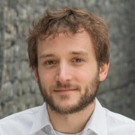




Next steps
In this hands-on we used an intermediate TiGL fork joergbrech/tigl as an example.
Let us keep our repository synchronized with the official TiGL Github repository
fork
pull
fork
PR
DLR-SC/tigl
joergbrech/tigl
username/tigl
push
Local Repository

Slide 33
Next steps
Optional first step: Delete your fork and create a new one, directly from the DLR-SC repository
Set the upstream repository to be DLR-SC/tigl:
Verify that everything worked:
To fetch all changes of the official TiGL repository type
And finally, to keep your local cpacs_3 (or any other) branch synchronized with the official TiGL release:
$ git remote set-url upstream https://github.com/DLR-SC/tigl.git
$ git remote -v
origin https://github.com/YOURUSERNAME/tigl.git (fetch)
origin https://github.com/YOURUSERNAME/tigl.git (push)
upstream https://github.com/DLR-SC/tigl.git (fetch)
upstream https://github.com/DLR-SC/tigl.git (push)
$ git fetch upstream
$ git checkout cpacs_3
$ git merge upstream/cpacs_3

Slide 34
Summary: The Contributing Workflow
Fetch changes from DLR-SC/tigl to your local repository and synchronize the main development branch
Create a branch for your feature and start coding. Don’t forget to commit your changes!
Push your changes to your Github Fork
Post a Pull-Request on Github. Note that you can choose any Github Fork of DLR-SC/tigl to which you would like to post the pull request.
$ git fetch upstream
$ git checkout cpacs_3
$ git merge upstream/cpacs_3
$ git branch my_fancy_tigl_feature
$ git checkout my_fancy_tigl_feature
# CREATE SOME AWESOME CODE
$ git add FILE1.cpp FILE2.cpp
$ git commit –m “Implemented a fancy feature”
$ git push

Slide 35
Congratulations! You are now a TiGL developer.

Slide 36

Further Ways to Contribute: Adaptations to CPACS
TiGL contains a class/enum for every geometry-related CPACS object in the schema.
Source Code for abstract classes for these CPACS objects are automatically generated by CPACSGen
The TiGL behavior of these objects is implemented (manually) in derived classes
CPACSGen (short for CPACS generator) is developed by RISC
It creates source code for classes and enums from the types defined in a CPACS XML schema file for the TiGL library
https://github.com/RISCSoftware/cpacs_tigl_gen
The .h and .cpp files in src/generated are created using CPACSGen
If you make adaptations to the CPACS schema, the code must be regenerated, derived classes must be adapted or created
Don’t forget to discuss your CPACS adaptations with the CPACS maintainers at DLR-SL
http://www.cpacs.de/
https://github.com/DLR-LY/CPACS

Slide 37
Further Ways to Contribute: cpacs2to3
CPACS 3 is released and we have a release candidate for TiGL 3.
TiGL 3 is NOT backwards-compatible to TiGL 2!
There are some major changes in regard to the component segment coordinates and guide curve definitions
For the transition from CPACS 2 to CPACS 3 we started developing a converter for cpacs files, hosted on Github: https://github.com/DLR-SC/cpacs2to3
Feel free to contribute!

Slide 38
Concluding remarks
We do not expect you to do our bugfixes for us!
But please do:
Let us know what you are working on
Report issues, post pull-requests
Don’t hesitate to contact us if you have any questions
Additional Information:
Google Test Primer https://goo.gl/mdYNvp
Standard Github Forking https://goo.gl/FXE5ye
TiGL Programmer‘s Guide https://goo.gl/oBjVpg
OpenCascade CheatSheet https://goo.gl/zZ9nrD

Slide 39

Questions
jan.kleinert@dlr.de
martin.siggel@dlr.de

